Slide 1

DEVELOPMENT OF REVERSE HLS FRAMEWORK
Megha Kumari (2311AI 53)
Supervised by:
Dr. Somanath Tripathy (Prof.)
Department of Computer Science and Engineering
Indian Institute of Technology Patna
03/12/2024

Slide 2
content
Introduction
Modern computer Architecture
What and why FPGA
Challenges with FPGA Development
Project Overview
Objective
Workflow
Dataset parameter
Data tokenization
Model and Architecture
Training configuration
Results
Future work
Reference

Slide 3
Introduction
Decompilation is a crucial process in translating low-level assembly code into human-readable high-level source code. It plays a vital role in:
Legacy Software Adaptation: Porting older programs to modern hardware.
Security Analysis: Detecting and analyzing malware.
In modern computing, co-processor-centric designs are becoming standard, with FPGAs (Field-Programmable Gate Arrays) at the forefront due to their:
Flexibility and reconfigurability.
Parallel processing capabilities.
Despite their advantages, proprietary FPGA compilers present challenges:
Verifying VHDL/Verilog code for security vulnerabilities.

Slide 4
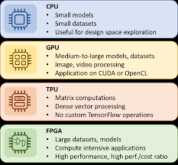
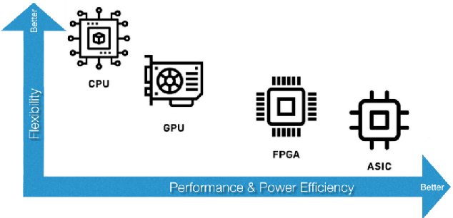
Modern Computer Architecture:-

Slide 5
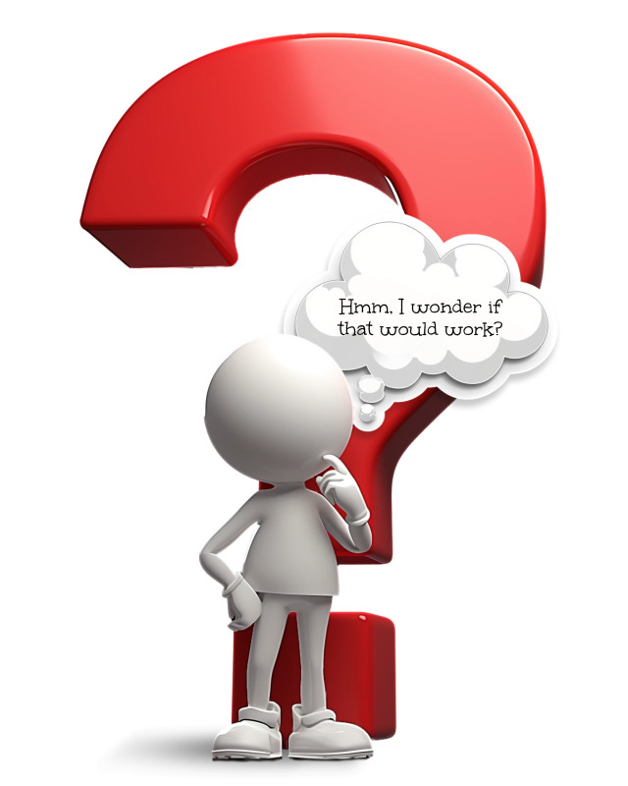
Why FPGA ?
What is FPGA?
Reconfigurable integrated circuit with thousands of Configurable Logic Blocks (CLBs).
Capabilities:
Dynamic circuit configuration to suit specific tasks.
Direct connectivity to network interfaces or sensors for high throughput.
Advantages Over CPUs and GPUs:
Faster for certain applications due to parallelism.
Flexible, reprogrammable nature suitable for evolving AI workloads
Long product lifespan for critical industries (e.g., aerospace, defense)..

Slide 6
Challenges with FPGA Development
Proprietary, closed-source FPGA compilers.
Limited debugging capabilities.
Lack of transparency in final Verilog/VHDL executables.
High dependence on specific vendor tools (e.g., Xilinx, Intel).

Slide 7
FPGAs in Security
Security Features in FPGAs:-
Custom hardware encryption and secure boot.
Resistant to tampering and replication.
Critical applications in secure communications and cryptographic operations.

Slide 8
Project Overview
Reverse Engineering Framework Reverse Engineering Framework for FPGAs
Reverse Engineering Framework for FPGAs
for FPGAs

Slide 9
Objective
Enable security analysis and verification of closed-source FPGA tools.
Develop a reverse compiler for Verilog/VHDL-to-high-level language translation.
Democratize FPGA application development

Slide 10
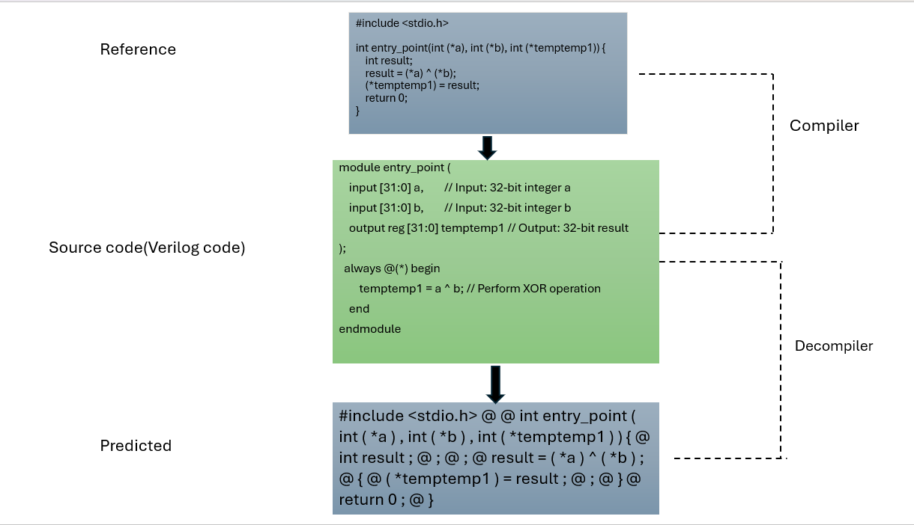

Slide 11
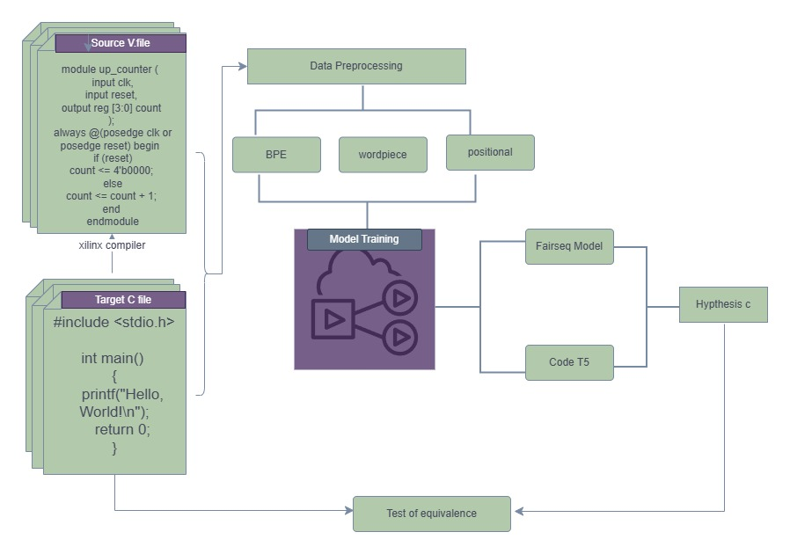
Model Architecture

Slide 12
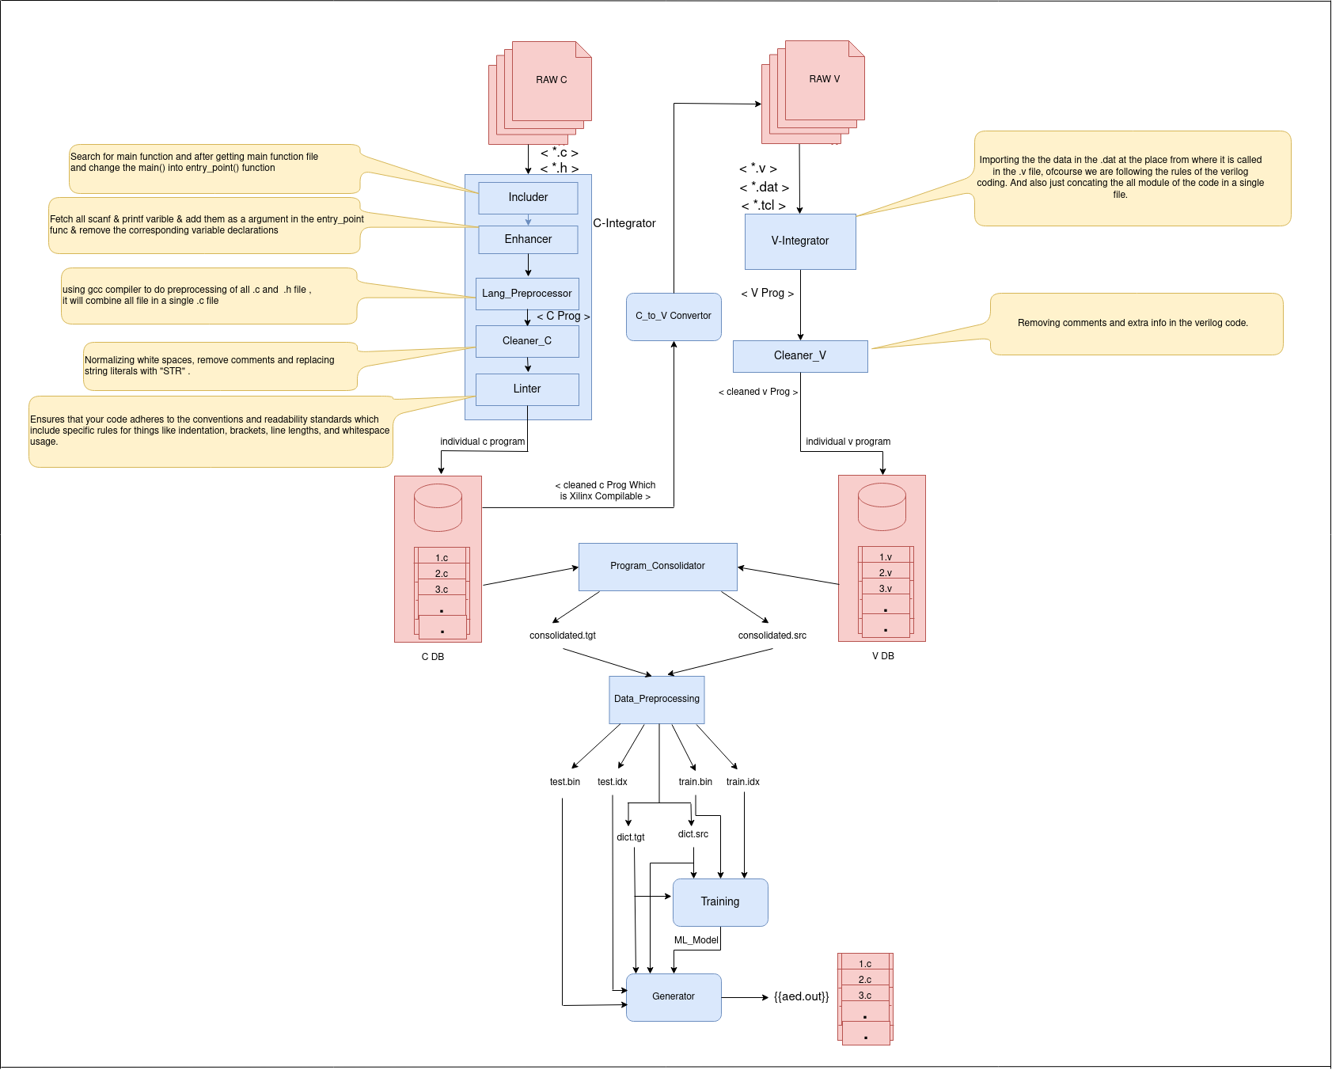
Workflow

Slide 13
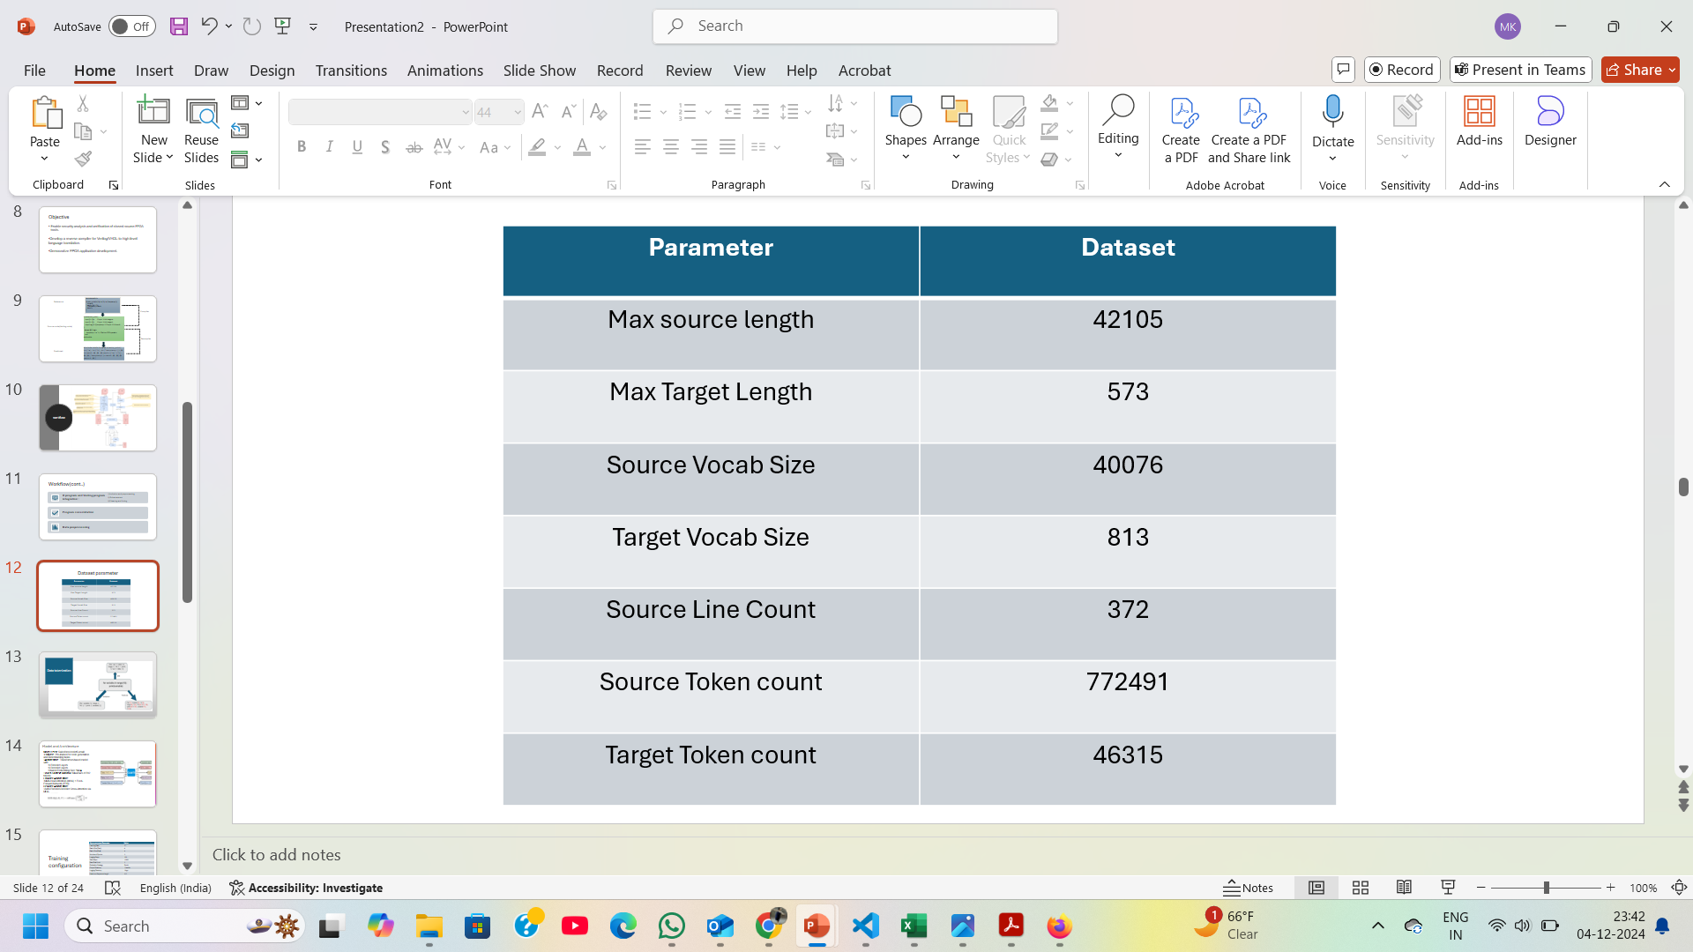
Dataset parameter

Slide 14
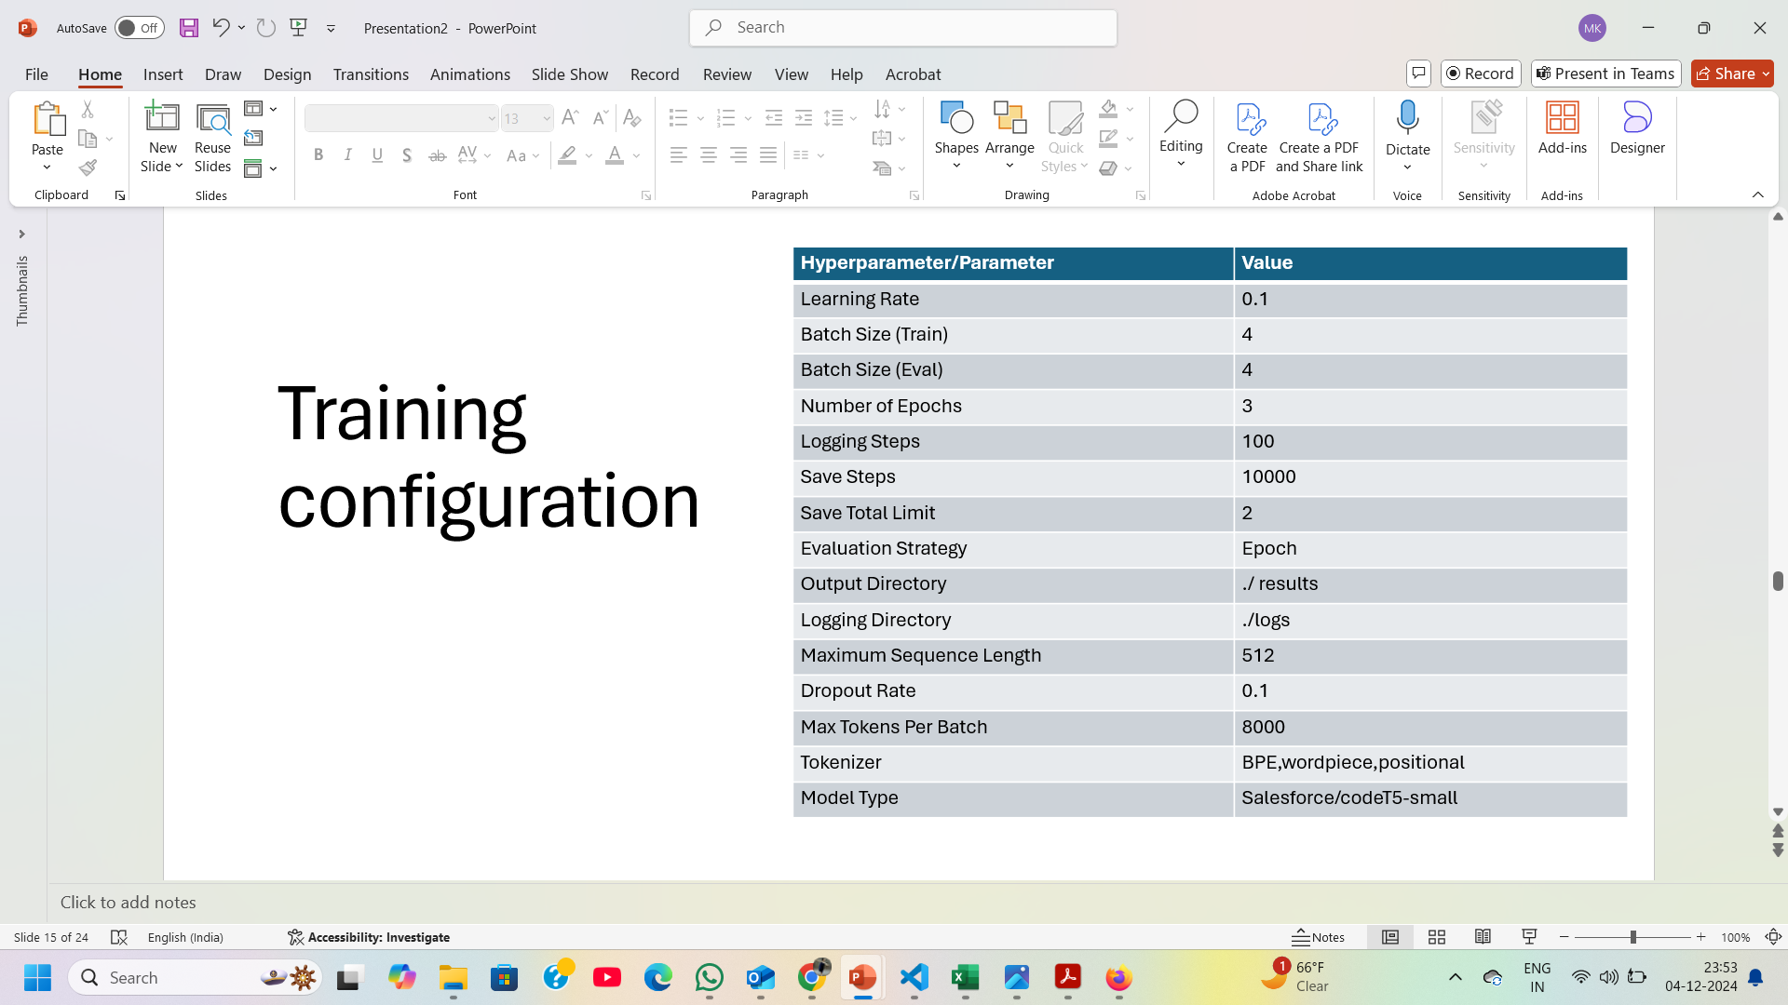
Training configuration

Slide 15
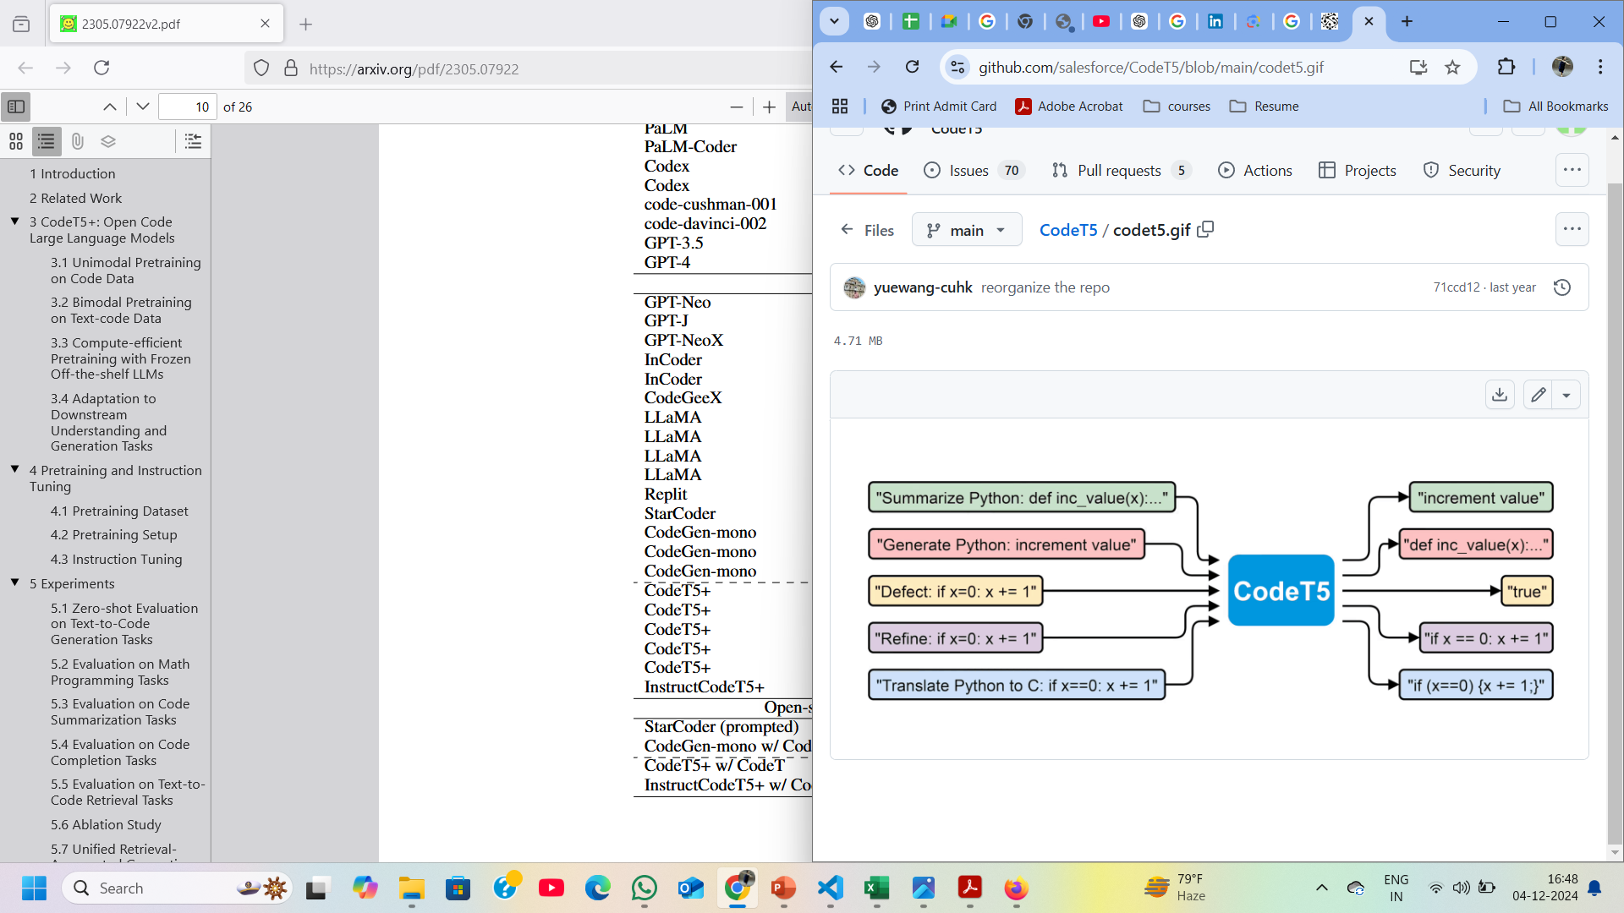
Model and Architecture
Model Used: Salesforce/codet5-small
Purpose: Pre-trained for code generation and understanding tasks.
Architecture: Transformer-based model with:
6 Encoder Layers
6 Decoder Layers
Shared Embedding Size: 1024
Token Context Window: Maximum of 512 tokens.
Encoder Architecture:
Multi-Head Attention (MHA) + Feed-Forward Network (FFN).
Decoder Architecture:
Adds Encoder-Decoder Cross-Attention via MHA.

Slide 16
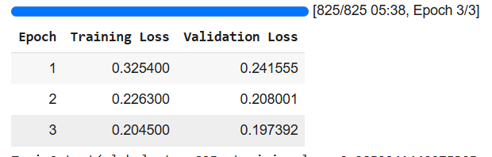
Results (cont.)[train output for bpe]
Metrics | Train output
global_step | 825
training loss | 0.2852241440975305
train runtime | 341.8502
train_samples_per_second | 9.653
total_flos | 446627944857600.0
train_loss | 0.2852241440975305
train_steps_per_second | 2.413

Slide 17
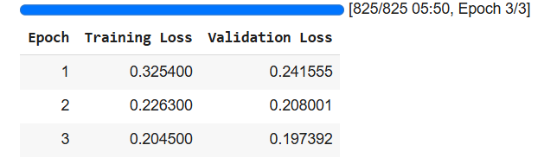
Results (cont.)[train output for wordpiece encoding]
metrics | TrainOutput
global_step | 825
training_loss | 0.2852241440975305
'train_runtime | 351.1853
train_samples_per_second | 9.397
train_steps_per_second | 2.349
total_flos | 446627944857600.0
train_loss | 0.2852241440975305

Slide 18
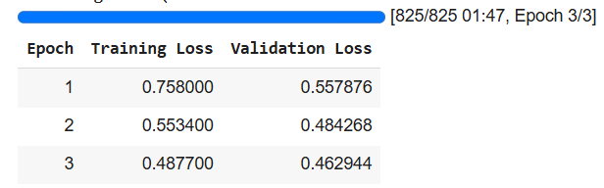
Results (cont.)[train output for positional encoding]
Metrics | Train output
global_step | 825
training_loss | 0.7040302473126036
'train_runtime | 108.1028
train_samples_per_second | 30.526
train_steps_per_second | 7.632
total_flos | 111656986214400.0
train_loss | 0.7040302473126036

Slide 19
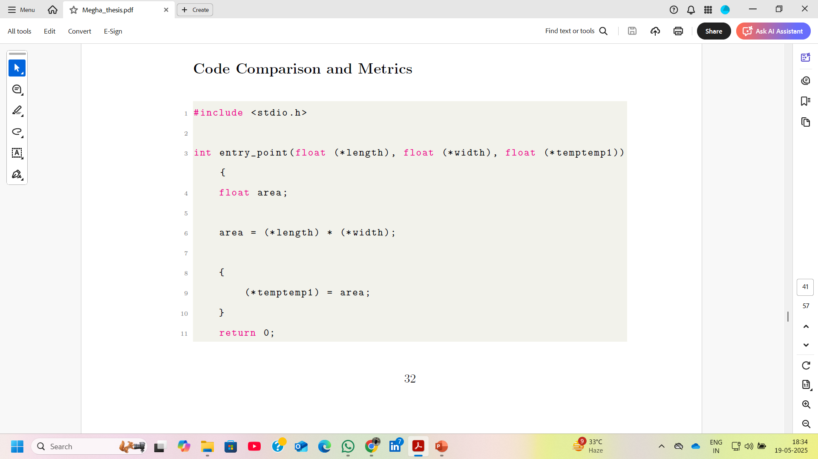
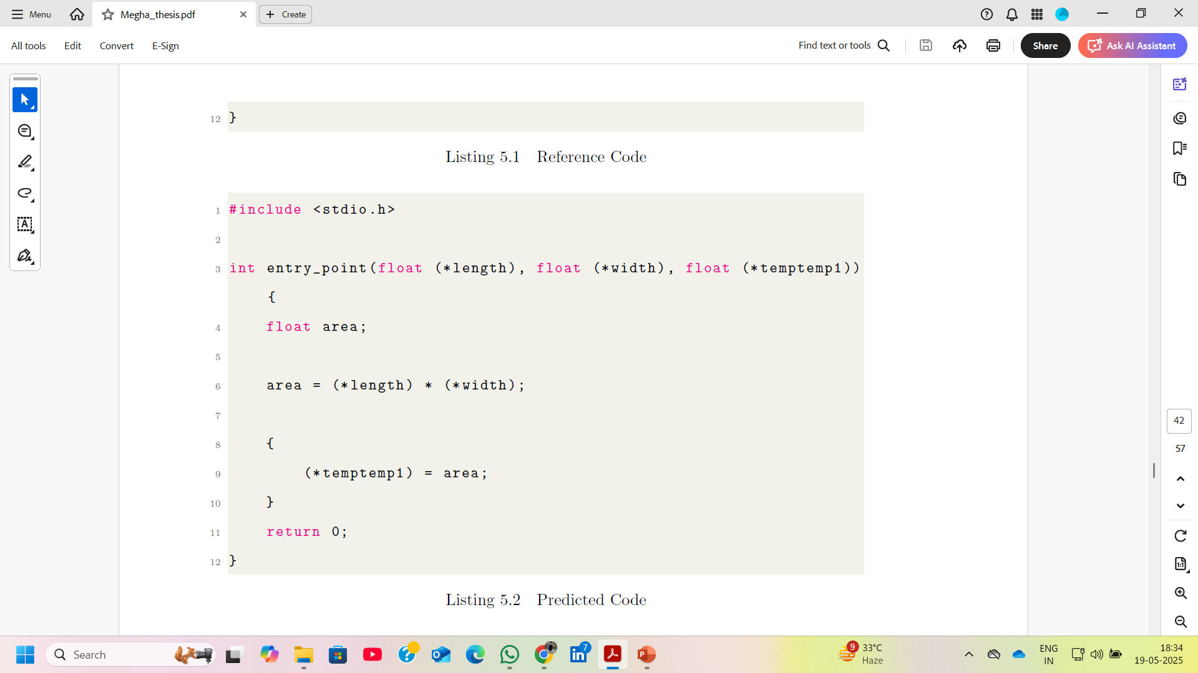
Result
Target
Predicted

Slide 20
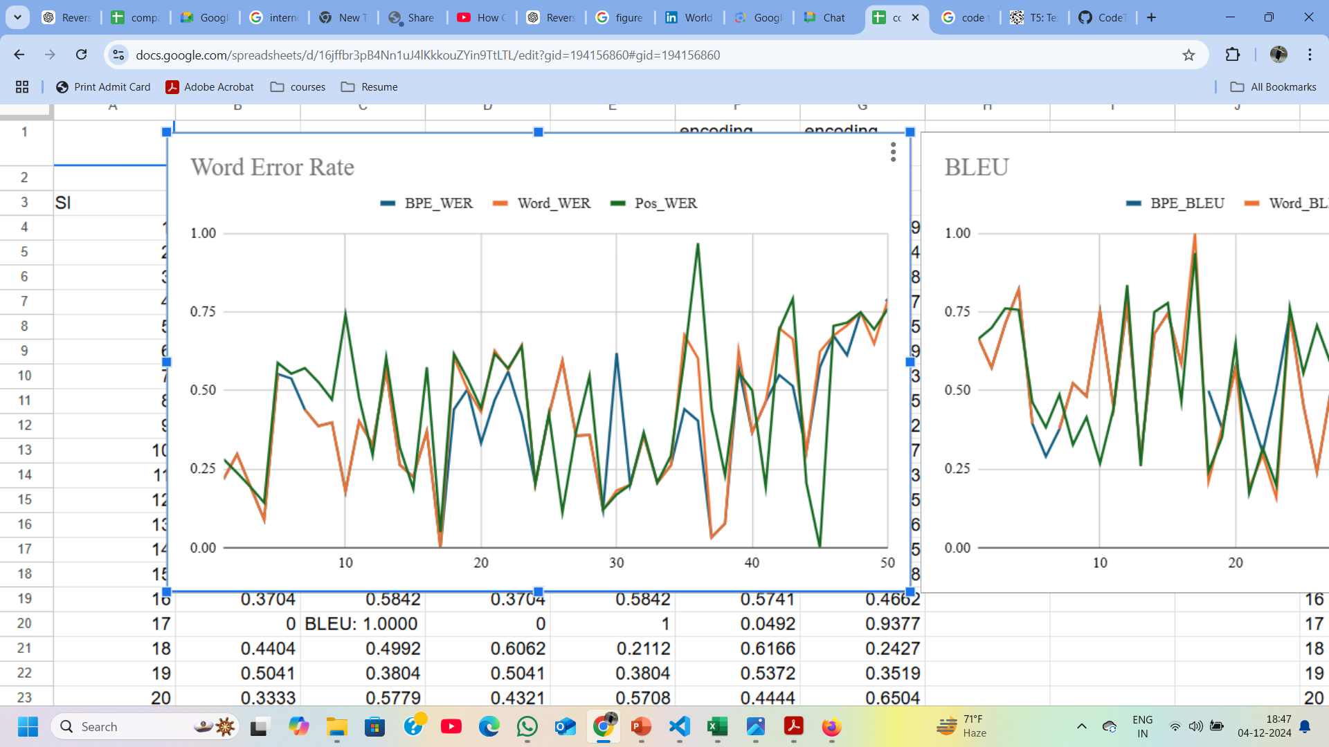
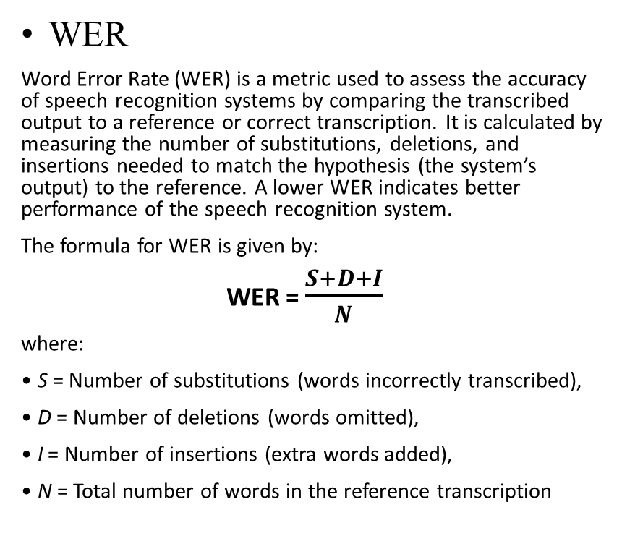
Evaluation Metrics for Encoding Technique
WER
Word Error Rate (WER) is a metric used to assess the accuracy of speech recognition systems by comparing the transcribed output to a reference or correct transcription. It is calculated by measuring the number of substitutions, deletions, and insertions needed to match the hypothesis (the system’s output) to the reference. A lower WER indicates better performance of the speech recognition system.
The formula for WER is given by:
WER = $\frac{S+D+I}{N}$
where:
• S = Number of substitutions (words incorrectly transcribed),
• D = Number of deletions (words omitted),
• I = Number of insertions (extra words added),
• N = Total number of words in the reference transcription

Slide 21
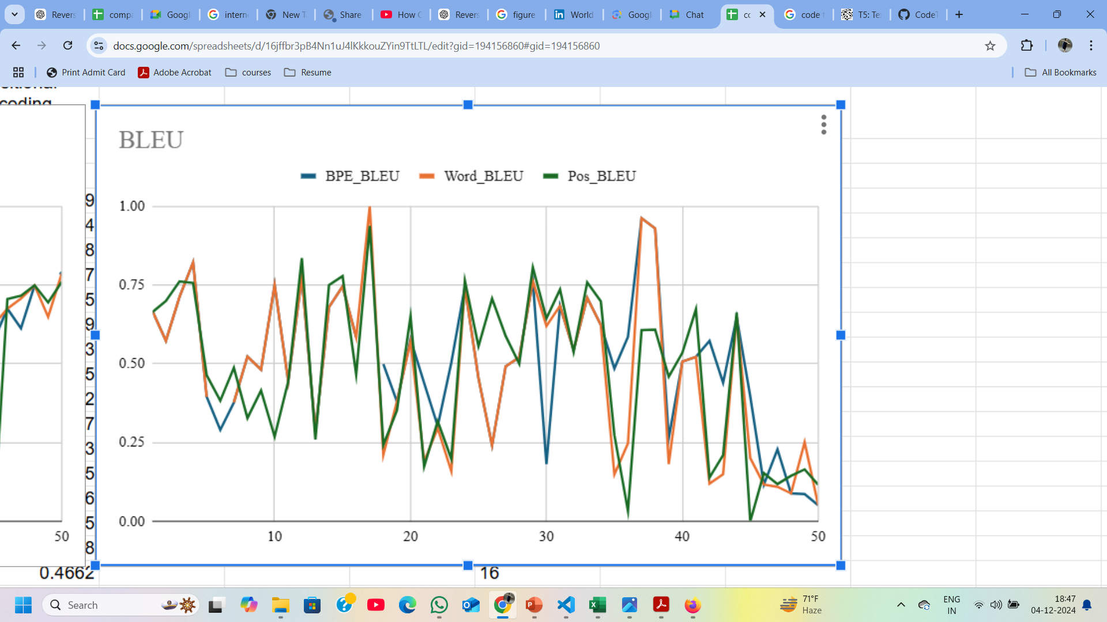
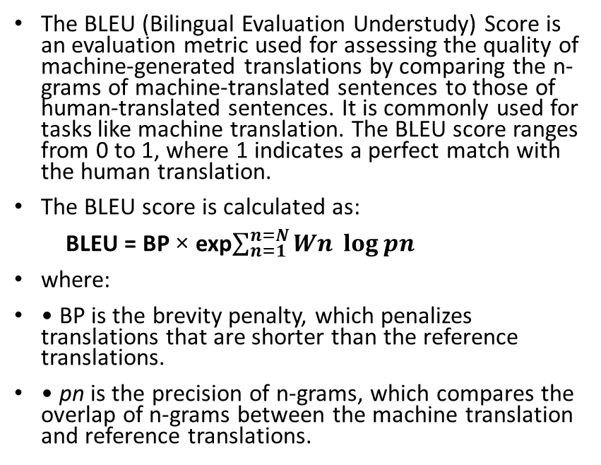
Evaluation Metrics(cont.)
BLEU Score
The BLEU (Bilingual Evaluation Understudy) Score is an evaluation metric used for assessing the quality of machine-generated translations by comparing the n-grams of machine-translated sentences to those of human-translated sentences. It is commonly used for tasks like machine translation. The BLEU score ranges from 0 to 1, where 1 indicates a perfect match with the human translation.
The BLEU score is calculated as:
BLEU = BP × exp$\sum_{n=1}^{n=N}{Wn \log{pn}}$
where:
• BP is the brevity penalty, which penalizes translations that are shorter than the reference translations.
• pn is the precision of n-grams, which compares the overlap of n-grams between the machine translation and reference translations.

Slide 22
Result
For FairSeq
For CodeT5
Encoding Technique | WER | BLEU
BPE | 0.56 | 0.47
WordPiece | 0.57 | 0.45
Positional | 0.59 | 0.42
Encoding Technique | WER | BLEU
BPE | 0.39 | 0.56
WordPiece | 0.40 | 0.49
Positional | 0.433 | 0.50

Slide 23
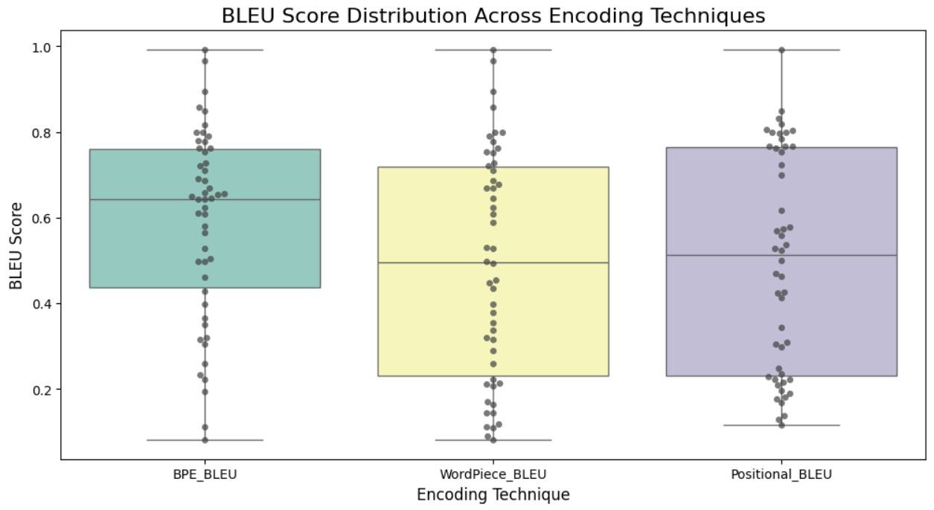
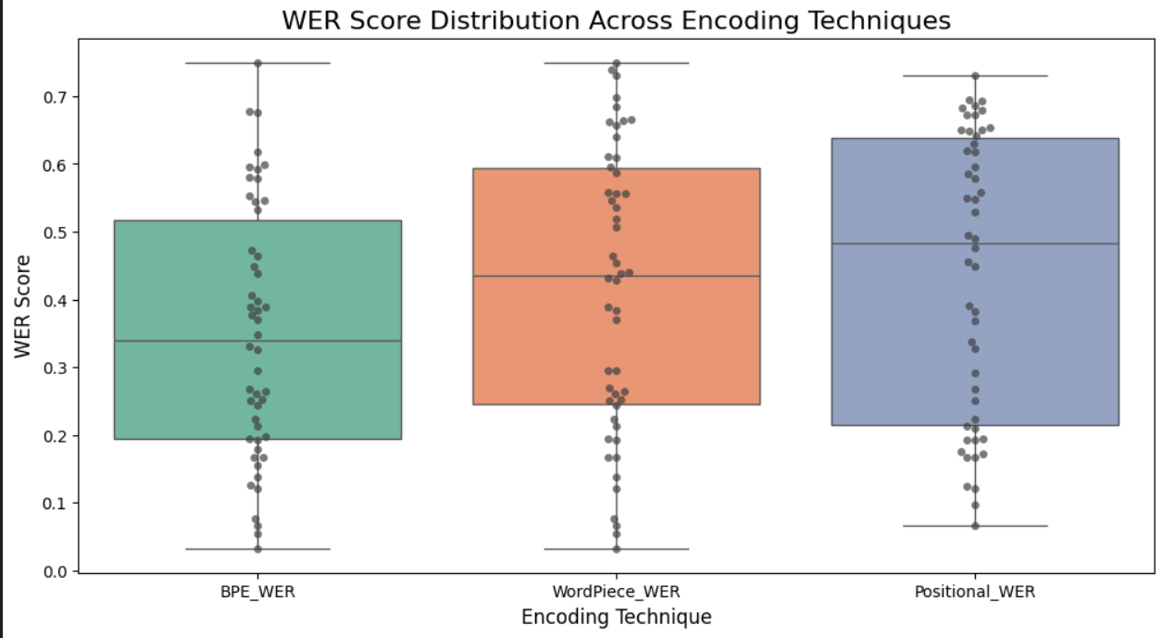
Result

Slide 24
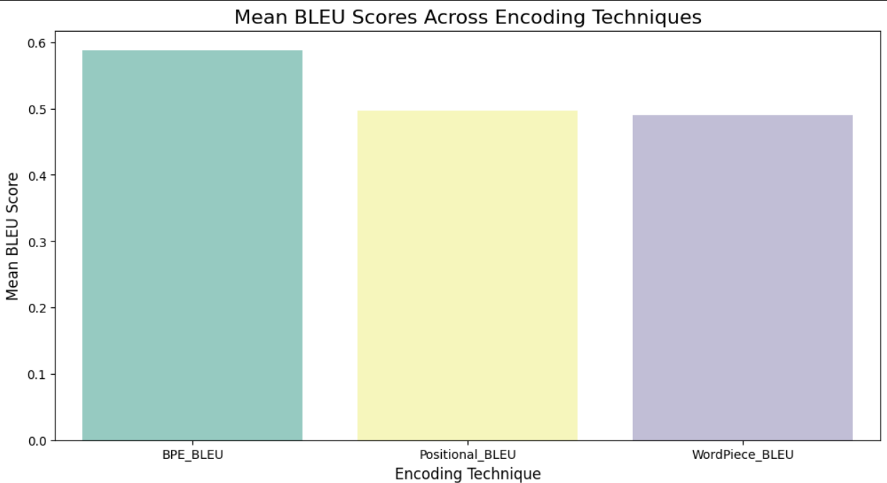
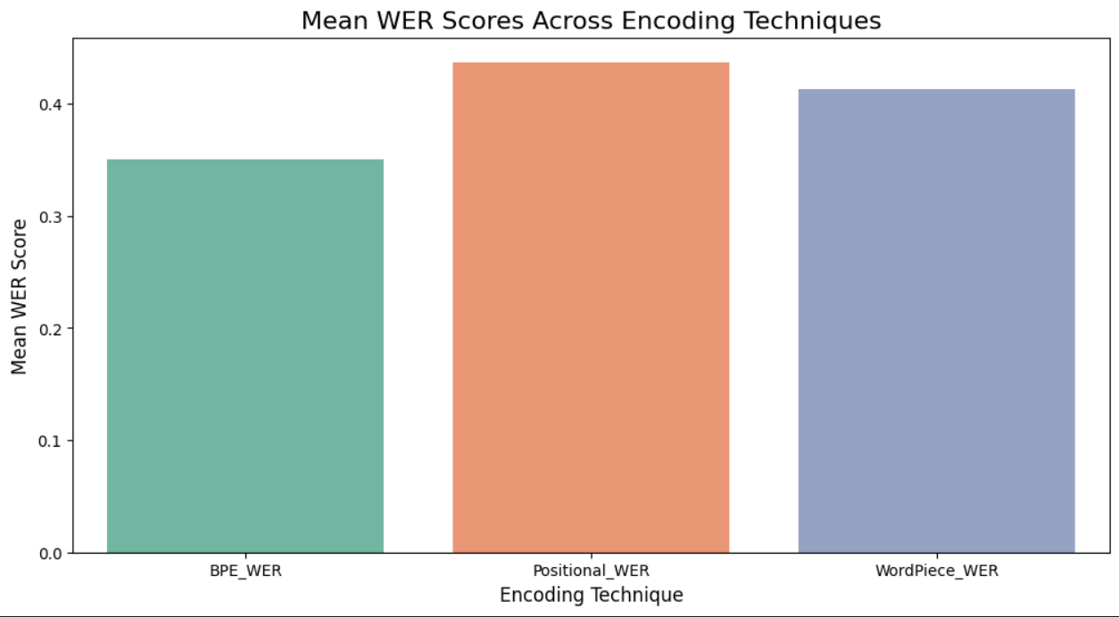
Result

Slide 25
Limitation
HLS models often struggle with nested conditional branches and irregular logic structures
Functions involving non-linear operations like square root are challenging for HLS
Floating-point computations are hardware-intensive and may be substituted with fixed-point arithmetic explicitly controlled
Loop unrolling and pipelining often pose challenges for HLS tools , especially when loop bounds are variable or data dependencies exist

Slide 26
Lim

Slide 27
Future work
• Expanding Dataset Diversity: Incorporating a wider range of programs and FPGA architectures to improve the generalization capabilities of the model.
• Refining Encoding Techniques: Enhancing tokenization methods to better capture the complexities of hardware description languages (HDLs) and high-level programming languages.
• Comprehensive Evaluations: Conducting extensive evaluations across additional programming languages and hardware platforms to assess the framework’s effectiveness and scalability.
These future directions will help in making the Reverse HLS framework more robust, versatile, and applicable to a broader range of FPGA development and optimization

Slide 28
Reference
J. Armengol-Estapé, SLaDe: A Portable Small Language Model Decompiler for Optimized Assembly,
available at: https://arxiv.org/pdf/2305.12520
Y. Wang, H. Le, A. D. Gotmare, N. D. Q. Bui, J. Li, S. C. H. Hoi, CodeT5+: Open Code Large Language Models for Code Understanding and Generation,
available at: https://github.com/salesforce/CodeT5/tree/main/CodeT5+JacksonWoodruff.
I. Hosseini, B. Dolan-Gavitt, C. Cummins, M. F. P. O’Boyle, Beyond the C: Retargetable Decompilation using Neural Machine Translation, available at: https://arxiv.org/pdf/2212.08950
Abderehman, Rupak Gupta and Chandan Karfa Indian Institute of Technology Guwahati, India {ma.adem, rgupta, ckarfa}@iitg.ac.in: Reverse Engineering Register to Variable Mapping in Highlevel Synthesis
https://github.com/facebookresearch/fairseq

Slide 29
Thank you Do have any question ?

